Slide 1
M&A project cyber risk reporting
Powered by

Slide 2
Project Overview
Project Name:
Acquired Company:
Acquisition Date:
Project Goals: [e.g., data migration, compliance alignment]
Current Status Summary
Provide a high-level overview of the project status. Highlight key milestones reached, current activities, and upcoming tasks
Powered by

Slide 3
Key Risks and Mitigation Strategies
Risk Area | Description of Risk | Mitigation Strategy | Current Status
Data Integration & Migration | Detail the potential data transfer vulnerabilities. E.g.Potential data breaches or data loss during migration; data incompatibility issues. | Describe what secure data transfer protocols will be implemented. E.g. Data transfer encryption or regular data validation checks | On Track / At Risk / Completed
Network Integration
Compliance & Regulatory
System Compatibility
Business Process Alignment
Security & Access Control
Vendor & Third-Party Risks
Communication & Coordination
Powered by

Slide 4
Budget and Resource Allocation
Resource Category | Budgeted Amount | Actual Spend | Variance
Personnel | [Amount] | [Amount] | [Difference]
Tools and Technology
Consulting and Third-Party Services
Upcoming Milestones and Next Steps
[List key upcoming milestones for the next reporting period, e.g., network cutover, data migration completion]
[List key next steps, e.g., compliance audit, final integration testing]
Key Decisions Requested from the Board
[List any key decisions or approvals required from the Board, e.g., budget adjustments, policy exceptions]
Powered by

Slide 5


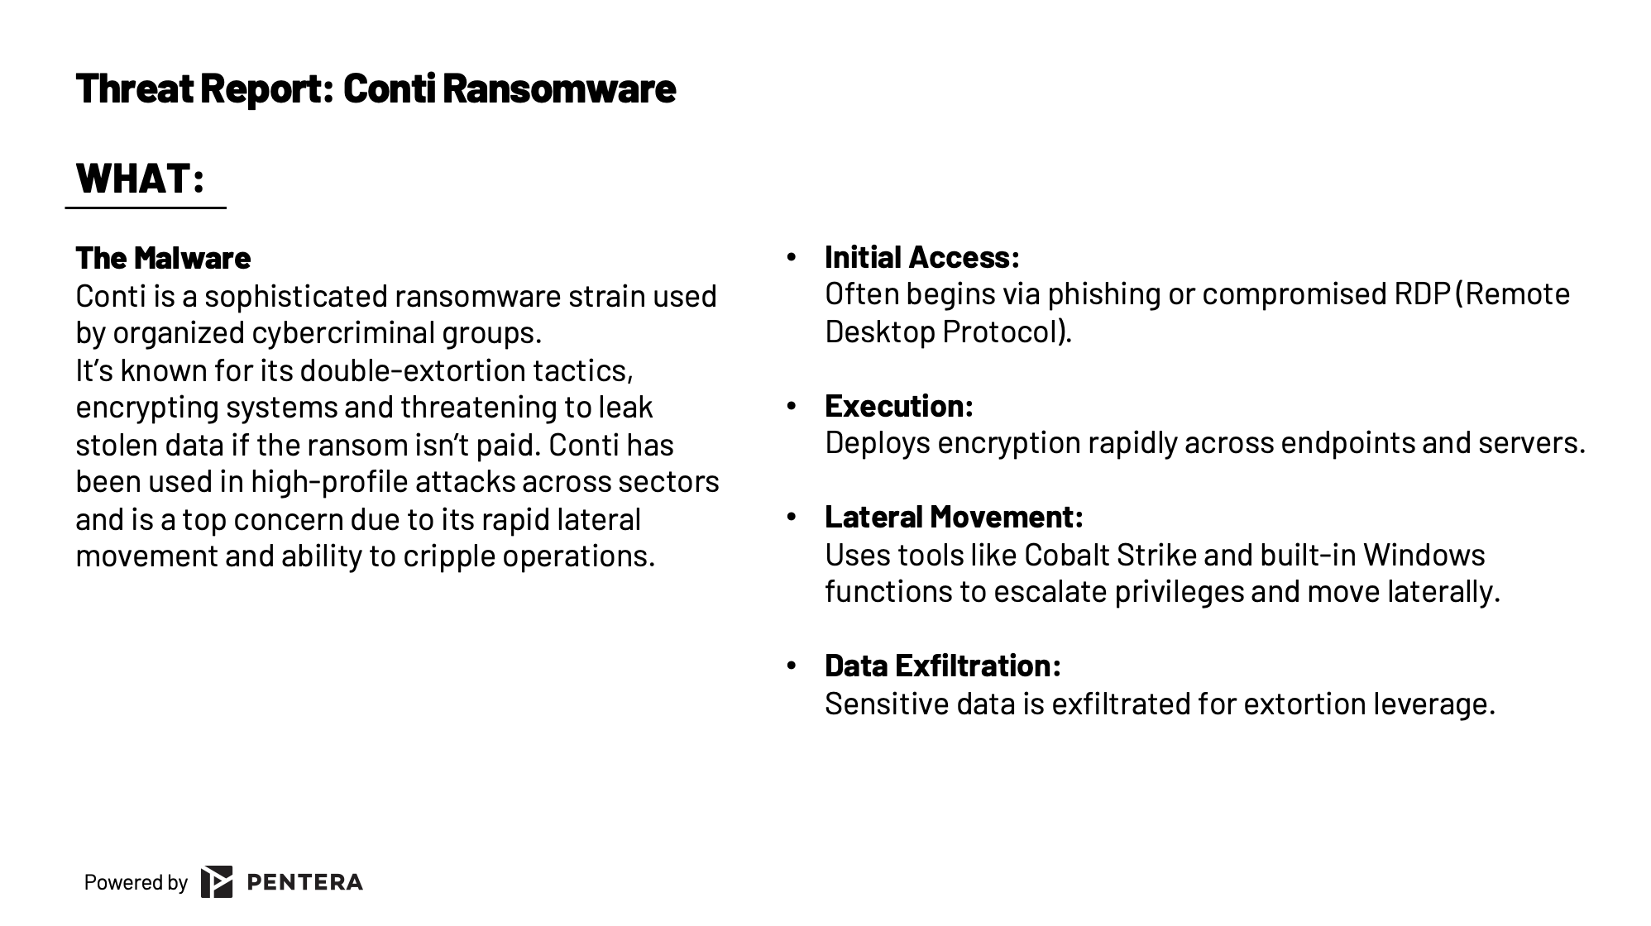
Celebrity Threat Report Template
Facing evolving cyber threats like Conti? This Celebrity Threat Report Template provides a structured, actionable framework to understand, test, and address critical security gaps. Gain insights into malware mechanics, validate your defenses, and communicate risks effectively. Protect your organization from high-impact attacks—get the template now.
Get Template

Slide 6

The GOAT Guide for Reporting to the Board
Learn how CISOs are speaking cyber risk with their BoD Tired of blank stares in the boardroom? This guide is your Rosetta Stone to speaking cyber risk in a language your board understands. Learn to turn technical truths into compelling business insights, demonstrate progress with outcome-driven metrics, and become the trusted advisor your organization needs to navigate today's complex threat landscape.
Download Guide

