Slide 1
Threat Report: Conti Ransomware
WHAT:
The Malware
Conti is a sophisticated ransomware strain used by organized cybercriminal groups.
It’s known for its double-extortion tactics, encrypting systems and threatening to leak stolen data if the ransom isn’t paid. Conti has been used in high-profile attacks across sectors and is a top concern due to its rapid lateral movement and ability to cripple operations.
Initial Access:
Often begins via phishing or compromised RDP (Remote Desktop Protocol).
Execution:
Deploys encryption rapidly across endpoints and servers.
Lateral Movement:
Uses tools like Cobalt Strike and built-in Windows functions to escalate privileges and move laterally.
Data Exfiltration:
Sensitive data is exfiltrated for extortion leverage.
Powered by

Slide 2
Threat Report: Conti Ransomware
SO WHAT:
What’s the Potential Business Impact?
Disruption:
Our company inventory database would be encrypted and unavailable. This would halt service order fulfillment and disrupt supply chain operations across multiple facilities.
Lost Business:
Our users would be locked out of the database and no service orders could be made. This would be a direct hit to revenue with potentially millions in downtime costs, delayed shipments, and SLA penalties.
Public Exposure:
Exposed data could include supply chain sources, financial data and shipping details. If leaked, it could impact customer trust, trigger regulatory scrutiny, and generate negative press coverage.
Recovery Costs:
Beyond ransom demands, we could face high costs in forensic investigations, remediation, third-party audits, and cyber insurance adjustments.
Powered by

Slide 3
Threat Report: Conti Ransomware
NOW WHAT:
What’s Been Done
Short-term:
Accelerating rollout of PAM (Privileged Access Management)
policies across all business units.
Ongoing:
Weekly retesting of high-value segments to confirm no regression.
Upcoming:
Incorporating Conti TTPs into our quarterly
tabletop exercise.
Board Support Needed:
Approving budget for extended coverage of backup
and recovery testing under emulated ransomware conditions.
Powered by

Slide 4


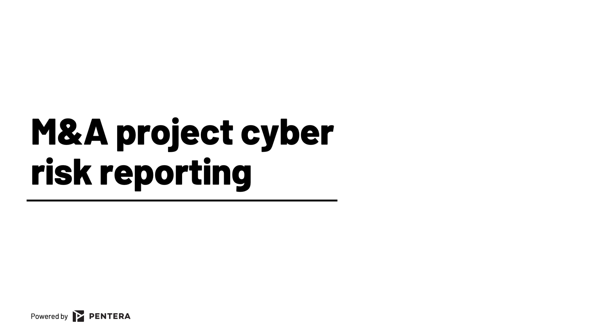
M&A Reporting
Template
Streamline your M&A cybersecurity reporting with this comprehensive template. It covers project overviews, current status, key risks and mitigation, budget allocation, and upcoming milestones. Designed for clarity and efficiency, it helps you communicate critical cybersecurity aspects to stakeholders, ensuring smooth integration and compliance. Get organized and stay ahead.
Get Template

Slide 5

The GOAT Guide for
Reporting to the Board
Learn how CISOs are speaking cyber risk with their BoD
Tired of blank stares in the boardroom? This guide is your Rosetta Stone to speaking cyber risk in a language your board understands. Learn to turn technical truths into compelling business insights, demonstrate progress with outcome-driven metrics, and become the trusted advisor your organization needs to navigate today's complex threat landscape.
Download Guide

