Slide 1
Security Posture Update
Logo placeholder
[Quarter/Year]
Placeholder graphic
Placeholder graphic
Key Risk Insights & Strategic Priorities for [Company Name] Board of Directors
[Your Name]
[Your Position Title]
Notes:
Notes:
Keep this slide clean and professional.
Replace placeholders with the appropriate quarter/year and company name.
No additional explanation is needed here—just use this slide to open the meeting and transition to the business context.

Slide 2
Security as a Business Enabler
Business Priority | Security Initiative | Business Impact
[Accelerate product launch] | [Assess for vulnerabilities in the CI/CD process] | [Reduced pre-release security delays by 40%]
[Meet NIS2 Enterprise compliance] | [Mapped security controls against NIS requirements] | [Passed external audit with no major findings]
[Build resilience of critical systems] | [Validate risk reduction effectiveness via CTEM framework] | [Validated security readiness in case of a breach]
Logo placeholder
Notes:
Notes:
Use this slide only if the board needs context on how security supports business goals.
Choose 2–3 core business priorities (e.g., time-to-market, regulatory compliance, resilience).
For each, describe the cloud security initiative supporting it and what impact it's having (e.g., faster deployments, reduced audit findings).
Keep explanations high-level and avoid technical language.

Slide 3
Security Posture Snapshot
Risk Trend
[⬇ 22% decrease in critical risks since Q2 2025]
Security KPIs
Risk-Based Metrics: [22% reduction in critical vulnerabilities quarter-over-quarter]
Operational Efficiency:
[Mean Time to Detect (MTTD): 5 hrs]
[Mean Time to Respond (MTTR): 11 hrs]
Security Automation: [76% of security policies auto-enforced]
Compliance Coverage: [94% of environments aligned to ISO 27001 & NIST CSF]
Top 9 Risks in Focus:
[Attack Vectors]
01 [% of employees failing phishing tests]
02 [Malware detections (trending up or down?)] 03 [DLP rules triggered (especially for customer data)]
[Defensive Posture]
04 [% of internet-facing assets patched within SLA]
05 [Crown jewel systems patched within xx days]
06 [% of internal servers lacking any compensating controls]
[Enterprise Risk]
07 [Third-party risk score for critical vendors]
08 [EDR coverage on servers and endpoints]
09 [Disaster Recovery testing success and recovery time]
Logo placeholder
Notes:
Notes:
Provide a snapshot of your current security posture.
“Risk Trend” should capture how overall risk has changed since the last board meeting.
Keep risk descriptions concise and business-relevant (e.g., “Identity sprawl increasing access risk”).
Select the 3–4 most relevant KPIs and fill in actual performance metrics.
Use visual cues (e.g., arrows or color indicators) to make changes clear over time.

Slide 4
Recent Security Incidents & Preparedness
What Happened? (The Incident) | So What? (Likelihood x Impact) | Now What? (What’s been done about it)
[Conti Ransomware - Executed a Conti-style attack to test organizational resilience] | [Seen in high profile attacks, Conti is known for its double-extortion tactics, encrypting systems and threatening to leak stolen data if the ransom isn’t paid. Identified lateral movement gaps and evaluated containment controls.] | [Accelerating rollout of PAM (Privileged Access Management) policies across all business units. Incorporating Conti TTPs into our quarterly tabletop exercise.]
[5 endpoints servers in the network were outside the scope of EDR coverage] | [These endpoints could provide potential access into the network and exposure to credentials in the Active Directory] | [The EDR agent within these endpoints has been confirmed as active and they are now operating under full coverage.]
Logo placeholder
Notes:
Notes:
Include this slide if a recent industry or internal event is relevant to the board.
Use one row for each event (up to two max).
Briefly explain the incident, assess your exposure, and summarize current preparedness.
Keep the tone calm and constructive—this is about demonstrating readiness, not fear.

Slide 5
Addressing Risks – Next Steps & Asks
Security Priorities
Cross-Functional Collaboration
Board Asks (If Any)
[Implement auto-remediation for identity over-permissioning]
[Expand automated pentesting coverage to remote environments]
[Working with DevSecOps team to enforce least privilege at deploy time]
[Partnering with HR to compile and up to date list of employee email addresses]
[Budget approval to expand CTEM tooling across all business units]
Logo placeholder
Notes:
Notes:
Include this slide if a recent industry or internal event is relevant to the board.
Use one row for each event (up to two max).
Briefly explain the incident, assess your exposure, and summarize current preparedness.
Keep the tone calm and constructive—this is about demonstrating readiness, not fear.

Slide 6

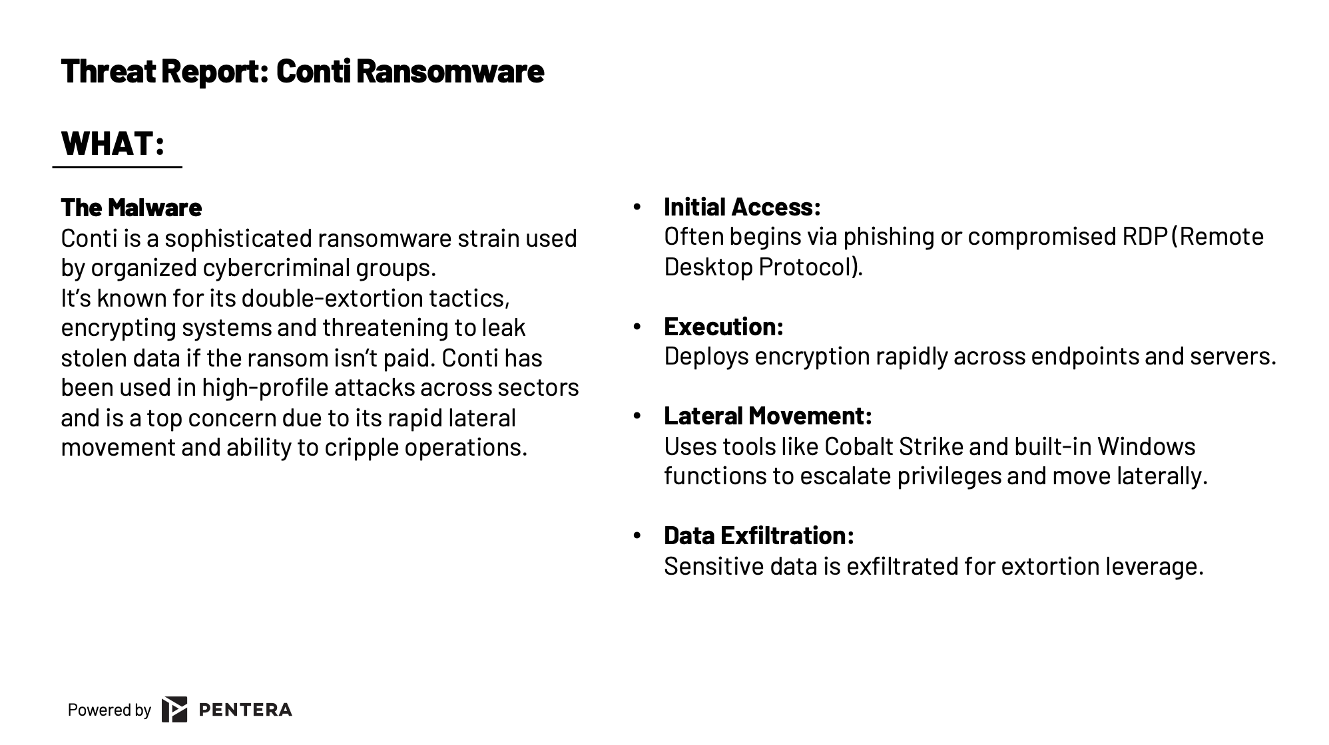
Celebrity Threat Report Template
Facing evolving cyber threats like Conti? This Celebrity Threat Report Template provides a structured, actionable framework to understand, test, and address critical security gaps. Gain insights into malware mechanics, validate your defenses, and communicate risks effectively. Protect your organization from high-impact attacks—get the template now.
Get Template

Slide 7
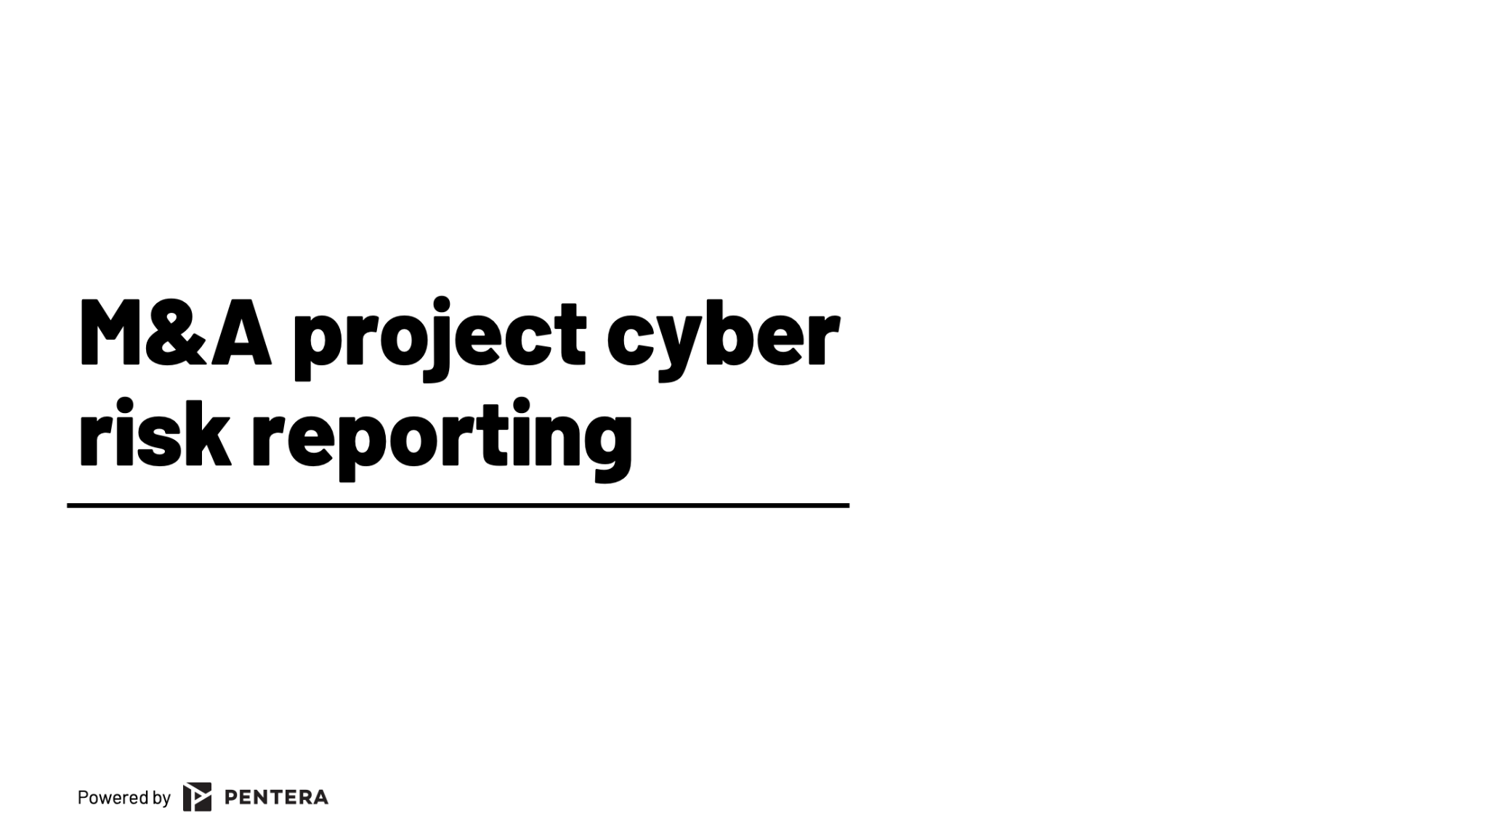
M&A Reporting Template
Streamline your M&A cybersecurity reporting with this comprehensive template. It covers project overviews, current status, key risks and mitigation, budget allocation, and upcoming milestones. Designed for clarity and efficiency, it helps you communicate critical cybersecurity aspects to stakeholders, ensuring smooth integration and compliance. Get organized and stay ahead.
Get Template

Slide 8

The GOAT Guide for Reporting to the Board
Learn how CISOs are speaking cyber risk with their BoD Tired of blank stares in the boardroom? This guide is your Rosetta Stone to speaking cyber risk in a language your board understands. Learn to turn technical truths into compelling business insights, demonstrate progress with outcome-driven metrics, and become the trusted advisor your organization needs to navigate today's complex threat landscape.
Download Guide

Slide 9
Thank you!

